Slide 1

Finding Mentors
TEAM 8027

Slide 2
Mentors
FIRST Robotics Competition team mentors of all kinds
Technical Mentors help with the programming and robot construction
Non-technical Mentors can help with the business and competition side of the program
Mentors can come from a variety of different sources: local universities, the FIRST community, other teams, and even parents
If your team needs help, you can even reach out to coaches/mentors on other teams

Slide 3
Sample Technical Mentors
Robot Programming/Software Engineering Mentor
■ Assist team members with writing code to control robot in C++, Java, Robot C or LabVIEW (depending on program)
■ Maintains process focus
Electrical Engineer Mentor
■ Assist team with wiring the robot’s power and signal system
■ Assist and instruct the team members in the electrical and electronics systems on the robot
Mechanical Engineer Mentor
■ Provides assistance with design and construction of the robot
■ Advise students on the safe use of tools and safety procedures
Source: FIRST

Slide 4
Sample Non-Technical Mentors
Project Management Mentor
■ Provides an overview of project management concepts for team
■ Guides the team throughout the project life cycle
Scholarship Mentor
■ Assist to educate students, Mentors and parents regarding scholarship opportunities available to FIRST students
■ Coordinates applications for student/ Mentor nominations for awards
Marketing Mentor
■ Provides a basic overview of Marketing concepts
■ Assists students with development and implementation of a Marketing Plan in coordination with the development of a Business Plan
Finance Mentor
■ Assist the team in preparing a Business Plan, financial planning/budget for the season
■ Organize and assists with fundraising efforts
Source: FIRST

Slide 5


Reach Out To Universities
Mentors can be found university faculty
Reach out to professors at local universities.
For example, our team found a CAD mentor at a local university

Slide 6
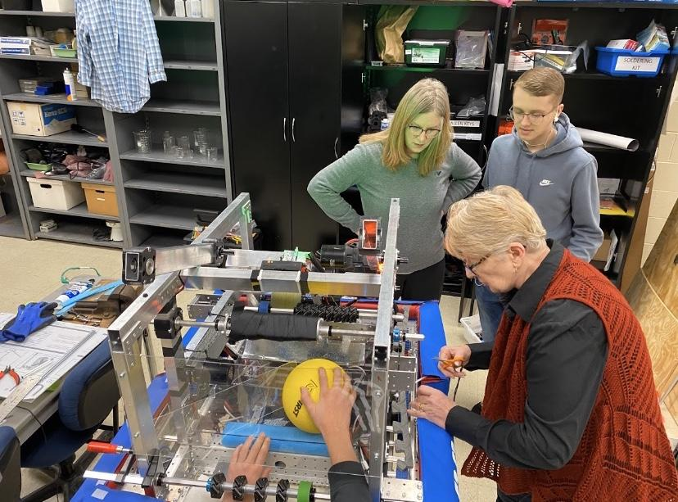
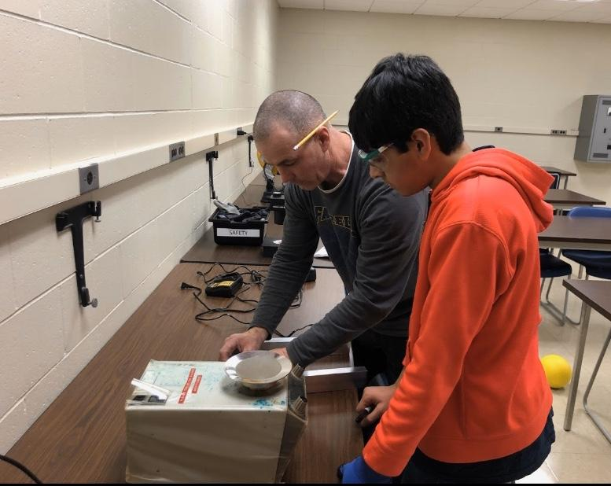
Reach out to Parents
Parents are often overlooked mentors
Make sure to ask your team parents if they have skill that might be useful for your team.
For example, our team parents and grandparents taught us how to to use our tools and even stopped by when we need help cutting, sawing and sewing our bumpers since our team did not have any prior experience

Slide 7
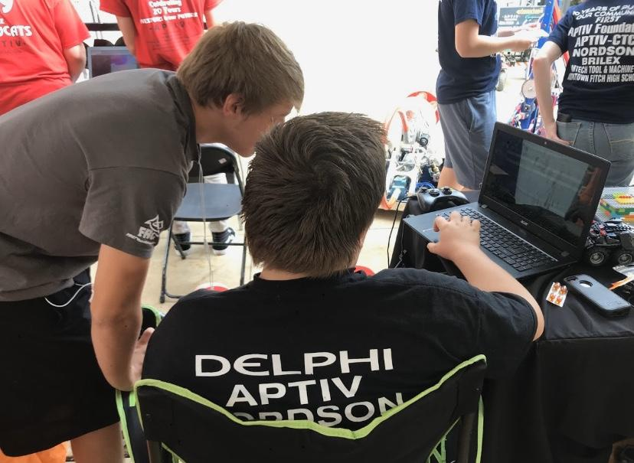
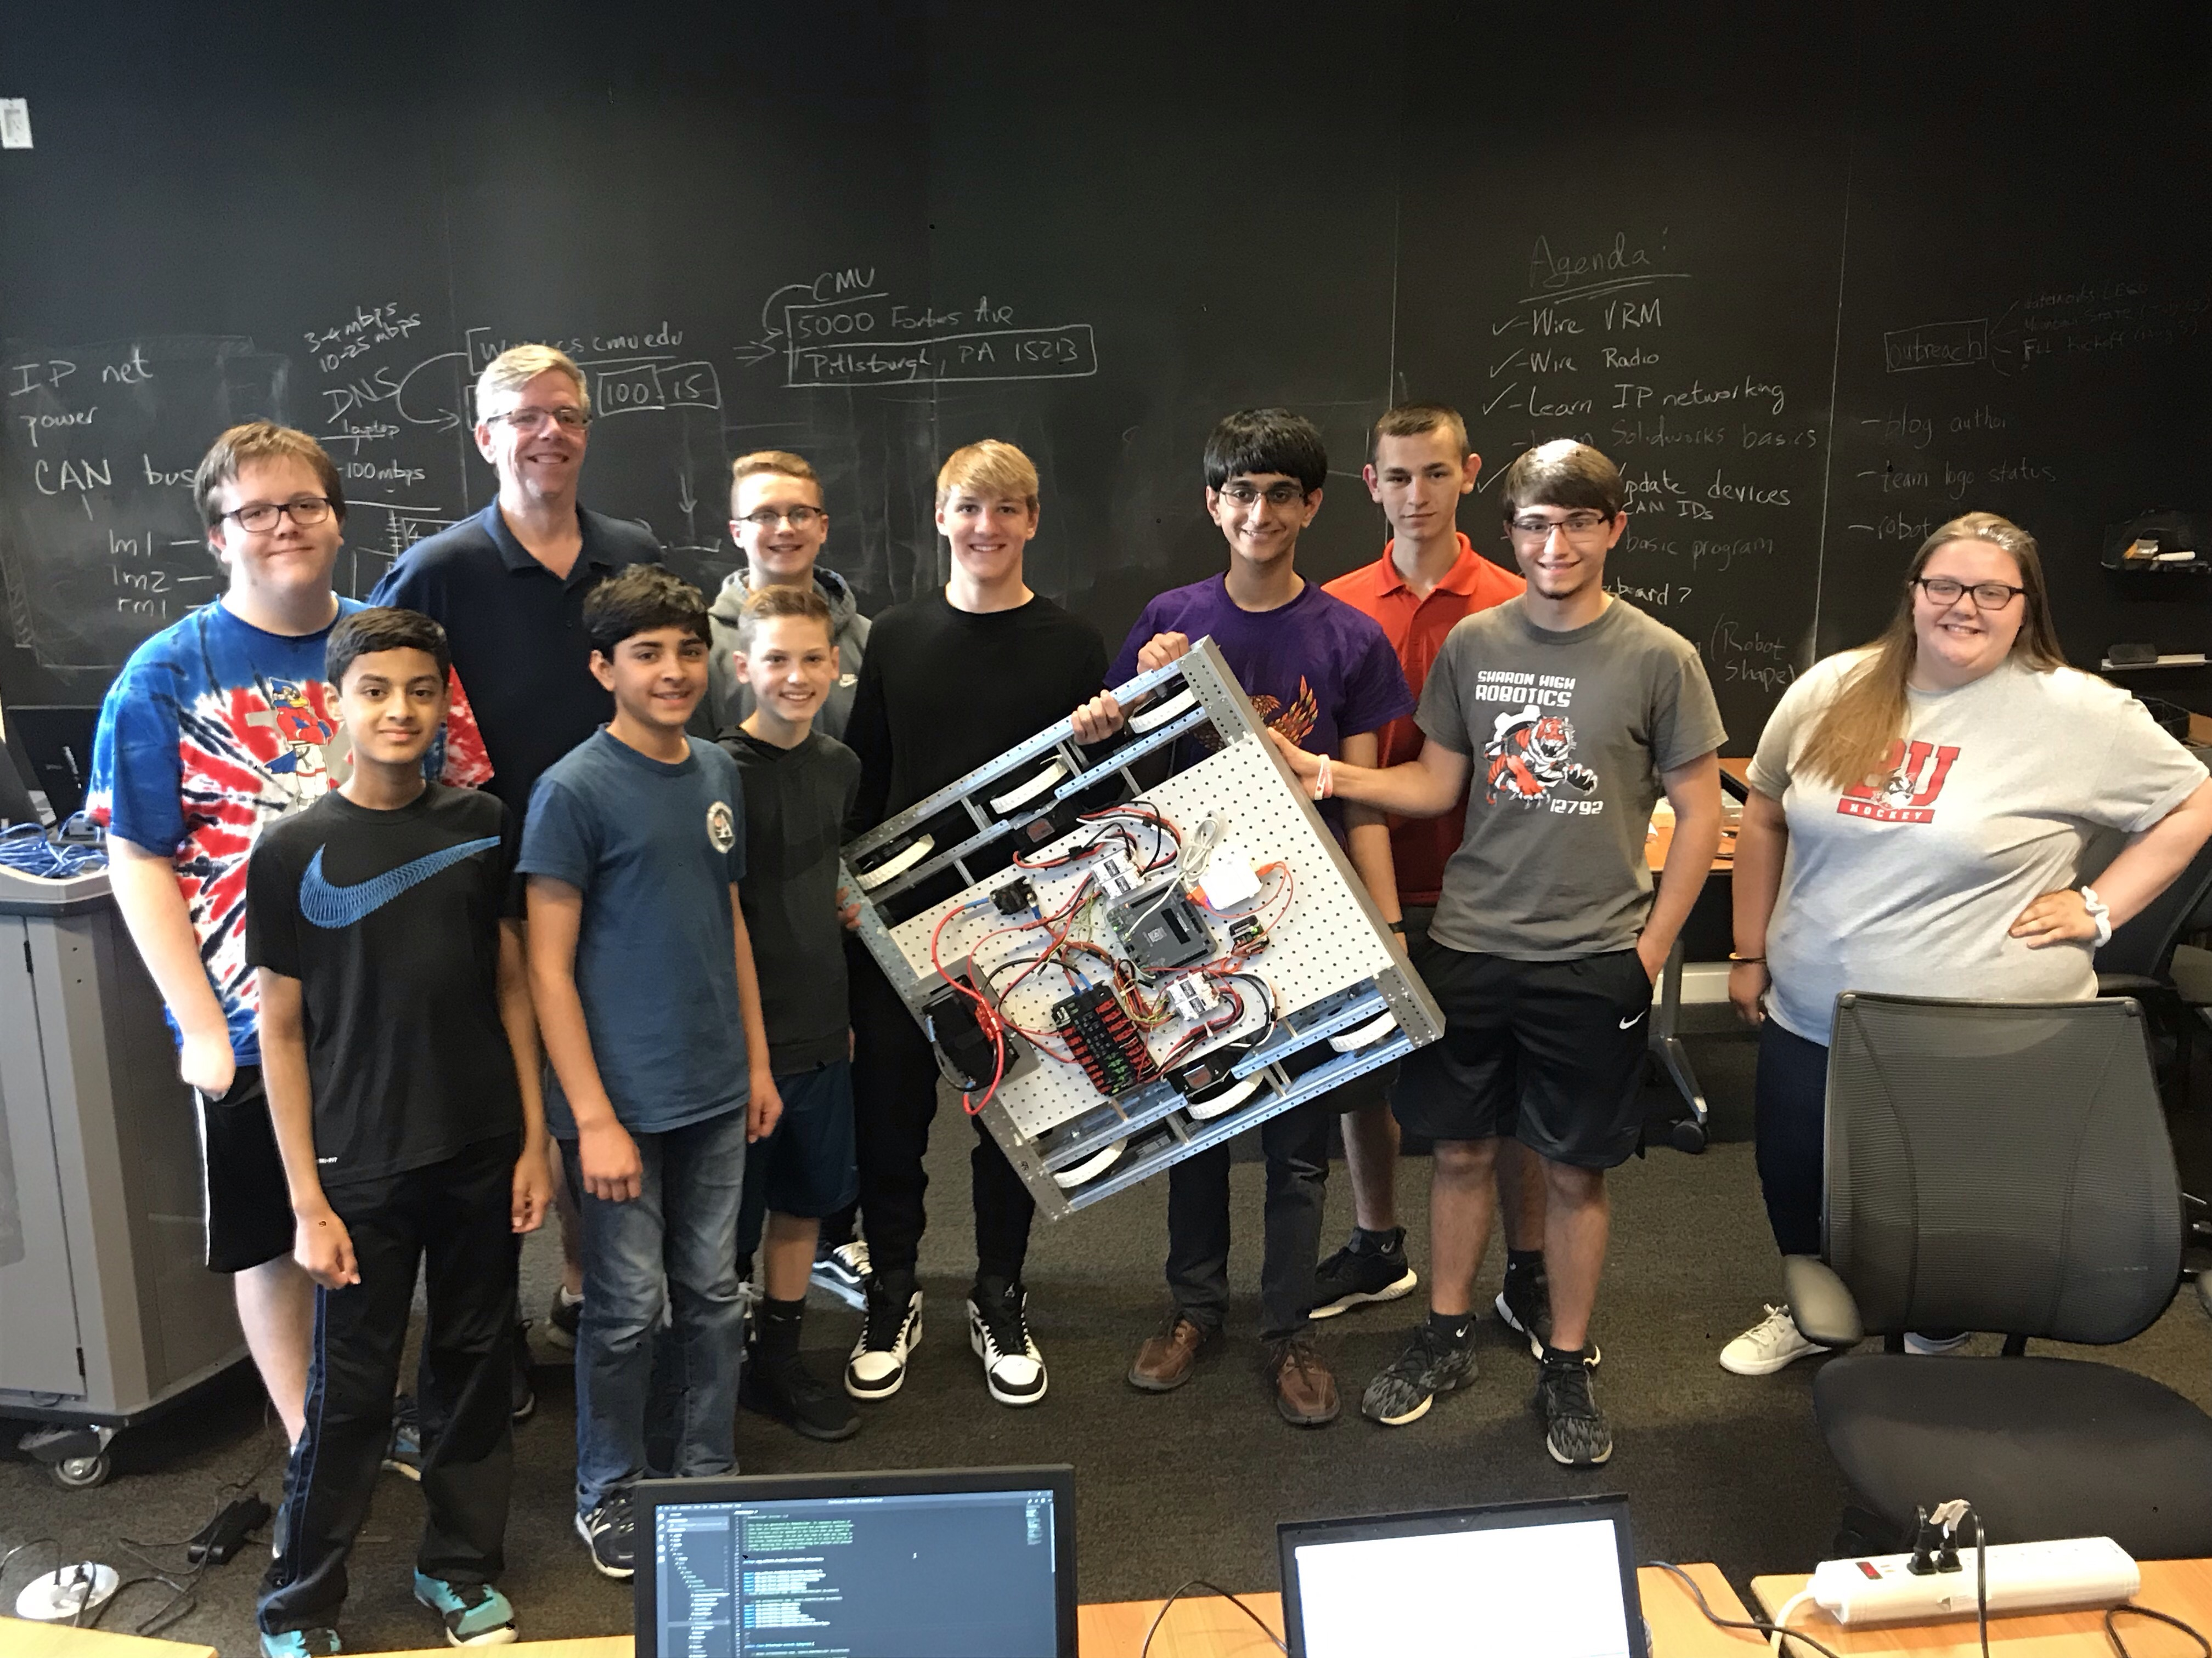
Mentors From Other Teams
Mentors can be found everywhere, and one common place to find and meet new teams is at events or competitions
Being allies with teams can build valuable relations on and off the field
Mentors at local scrimmages and competitions are always there to assist teams they are partnered with and those they are competing against

Slide 8
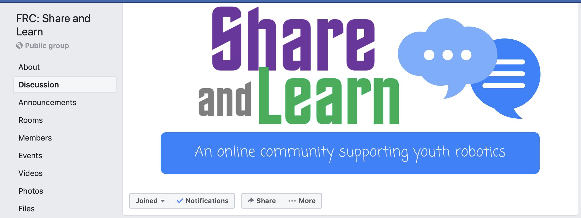
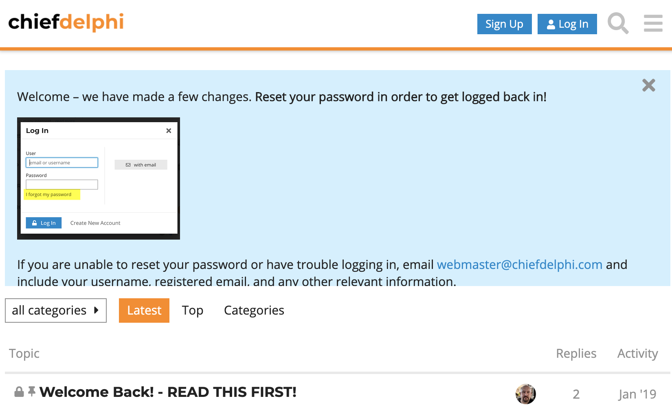
Reaching out to the Community
If you have questions, but do not necessarily need a full-time mentor, you can also reach out to coaches and mentors who you are not in the same location.
Chief Delphi is a popular platform for reaching out the FIRST Robotics Competition for help
FRC: Share and Learn Facebook Group, is also a place where teams can ask questions and get help from mentors all over the world (https://www.facebook.com/groups/FRCShareandLearn)

Slide 9
Useful Links
Mentoring Guide: https://www.firstinspires.org/sites/default/files/uploads/resource_library/frc
https://www.firstinspires.org/sites/default/files/uploads/volunteer/first-mentorcoachflyers-ftc-frc.pdf/game-and-season-info/2015-frc-mentoring-guide.pdf

Slide 10

Credits
This lesson was written by FRC 8027 for FRCTutorials.com
You can contact the author at team@droidsrobotics.org
More lessons for FIRST Robotics Competition are available at www.FRCtutorials.com
This work is licensed under a
Creative Commons Attribution-NonCommercial-ShareAlike 4.0 International License.

